Slide 1
Enterprise Applications
Your starting toolbox
Irinel Dan - Software Engineer
Loredana Costea - Software Engineer
March 2024

Slide 2
Training Agenda
Enterprise applications with Spring
W1. Enterprise applications - Your starting toolbox.
W2. How Spring can improve your life as a programmer.
W3. Dive into the Web.
W4. What is Spring Boot and why is everyone using it?
W5. Improve your application robustness with testing and API documentation.

Slide 3





Trainers Java Technology Group
Irinel Dan
Software Engineer
Alex Babei
Software Engineer
Emilian Marian
Software Engineer
Sorin Miron
Software Engineer
Loredana Costea
Software Engineer

Slide 4

Let’s get to know each other

Slide 5
Week 1 Timeline
9th March
Introduction, Java, IDE
Let’s get to know each other
What is a Java application?
Install & Setup Java and IDE
Break - Get up, grab a cup of coffee/tea and :)
Maven
What is Maven?
Install & Setup Maven
Build a Java application with Maven and IntelliJ IDEA
Break - Get up, grab a cup of coffee/tea and :)
Apache Tomcat
What is Apache Tomcat?
Install & Setup Apache Tomcat
Build and deploy in Tomcat a simple web application
Git
What is Git?
Install & Setup Git
Create GitHub Account

Slide 6
What is a Java application?

Slide 7
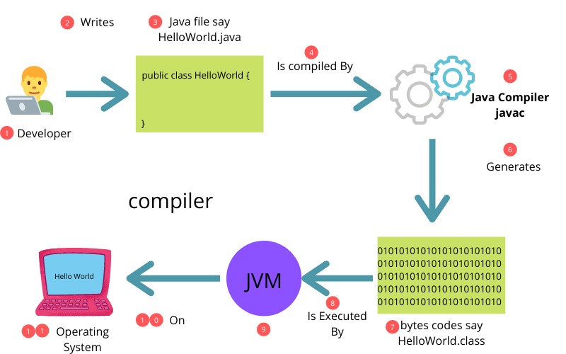
This is a Java application

Slide 8
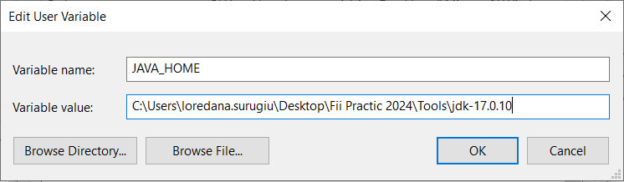
Java
Install & Setup
Download
JDK 17
https://www.oracle.com/java/technologies/javase/jdk17-archive-downloads.html
Add environment variables
Set JAVA_HOME

Slide 9
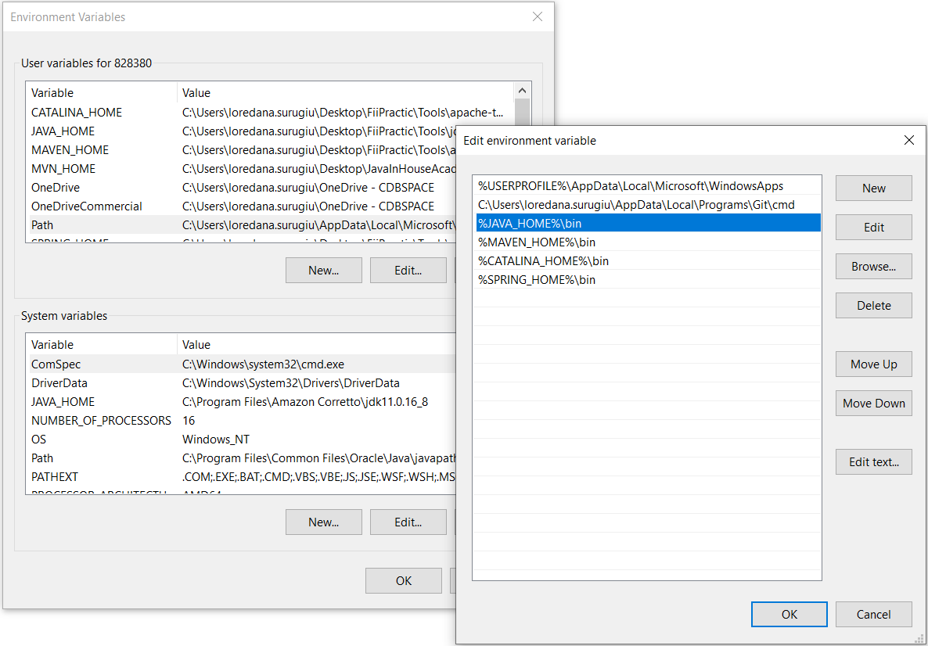
Java
Install & Setup
Edit environment variable​
​
​
Setup PATH

Slide 10
Using IntelliJ Idea to create your first application

Slide 11
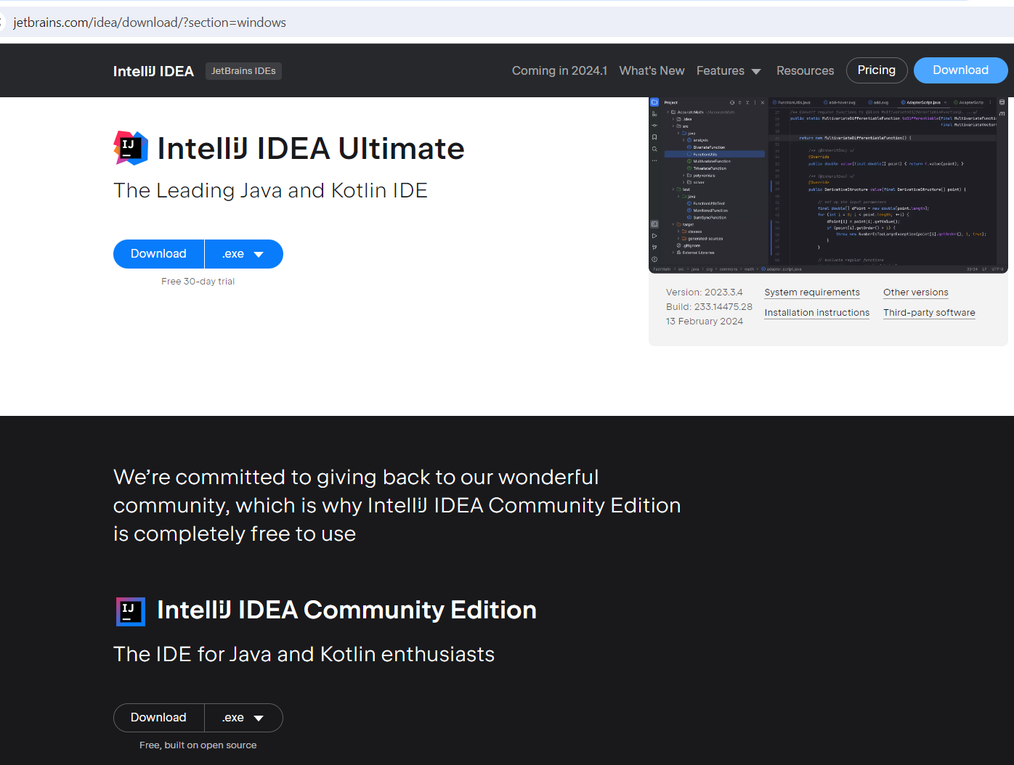
Using IntelliJ Idea to create your first application
Download
Community Edition
https://www.jetbrains.com/idea/download/?section=windows

Slide 12
What is Maven?

Slide 13
What is Maven?
High level overview
Maven = Build tool
Maven = Project
management tool
Manages dependencies
Produces an artifact
Handles versioning/releases
Favours convention over configuration
Apache Software Foundation
Open Source

Slide 14
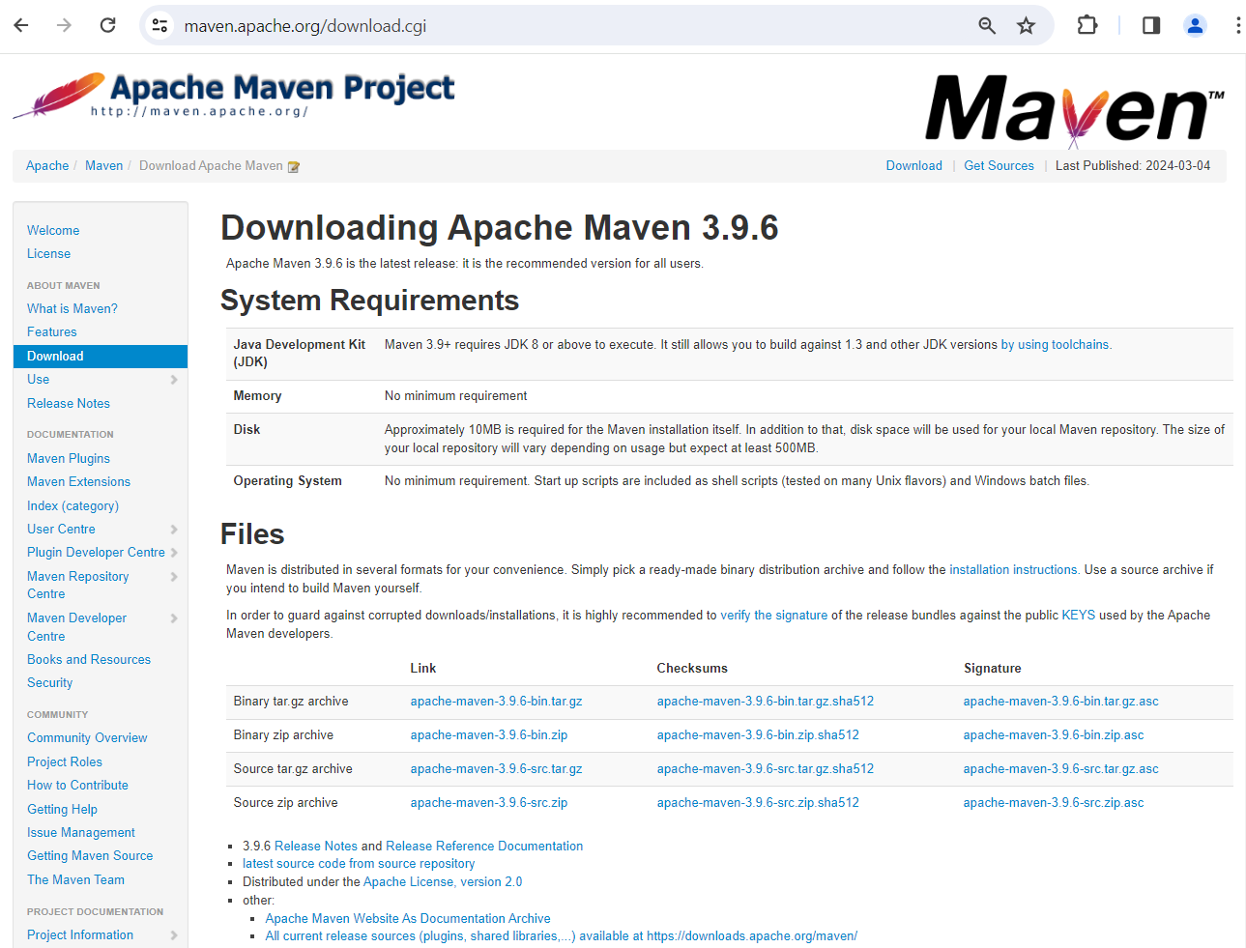
What is Maven?
Install & Setup
Download
3.9.6
https://maven.apache.org/download.cgi
Binary zip for Windows
Binary tar for Unix

Slide 15
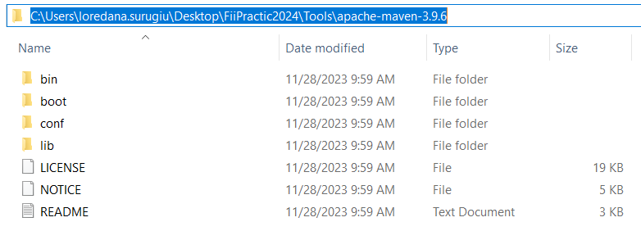
What is Maven?
Install & Setup
Installation
Unzip it and put it under the C drive

Slide 16
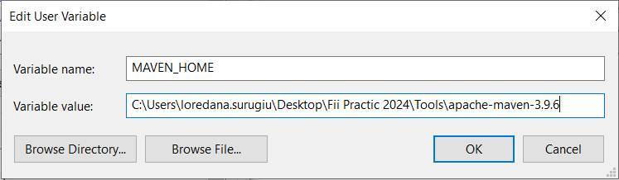
What is Maven?
Install & Setup
Add environment variables
JAVA_HOME
MAVEN_HOME

Slide 17
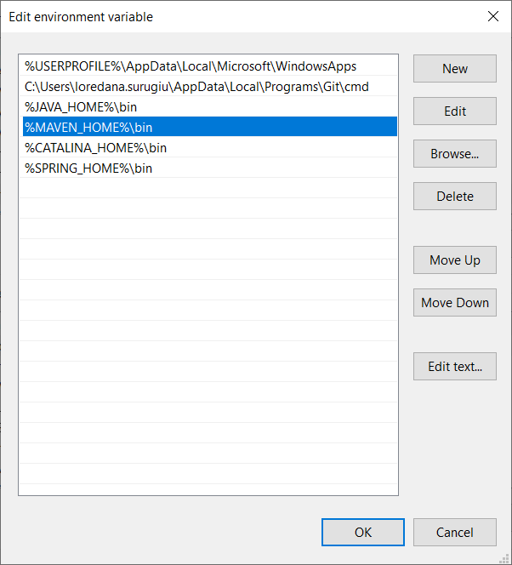
What is Maven?
Install & Setup
Edit environment variable
Setup Path

Slide 18
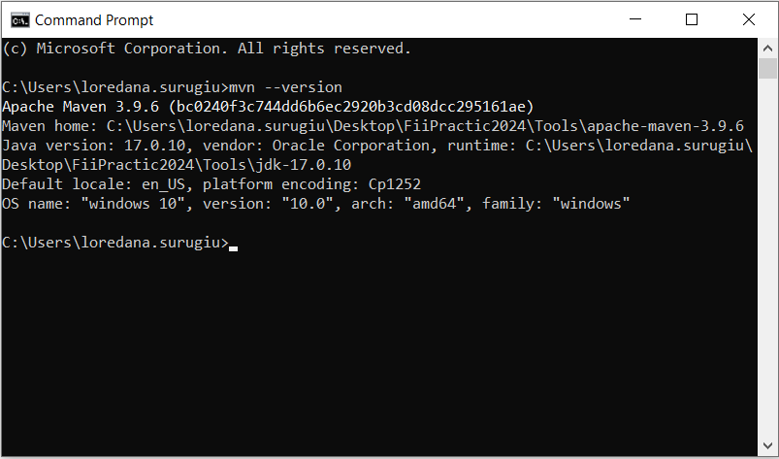
What is Maven?
Install & Setup
Verify installation
Open cmd
Run mvn --version

Slide 19
What is Maven?
Folder Structure
fiipracticprojectdir
src
main
java
resources
test
java
resources
target
pom.xml

Slide 20
What is Maven?
Dependencies
Maven POM
POM - Project Object Model
The pom.xml is XML document which describes a Maven Project
Must comply with the maven-4.0.0.xsd
XML Schema defining the 'rules' for the XML Document
POMs can inherit properties from a parent POM
"Effective POM" - is the POM complete with inherited properties

Slide 21
What is Maven?
Build Lifecycles
Maven is based on the concept of build lifecycles
A lifecycle is a pre-defined group of build steps called phases
Each phase can be bound to one or more plugin goals
Keep in mind all work done in Maven is done by plugins!
Lifecycles and phases provide the framework to call plugin goals in a sequence

Slide 22
What is Maven?
Build Lifecycles
Clean
Does the clean of the project, removes all build artifacts from working directory
Defined with plugin bindings
Default
Does the build, compiling, testing, deployment of our project
Defined without plugin bindings, bindings are defined for each packaging
Site
Create the website for you project
Least used in enterprise

Slide 23
What is Maven?
Build Lifecycles
Validate - Verify project is correct
Compile - Compile source code
Test - Test compiled source code
Package - Package compiled files to packaging
Verify - Run integration tests
Install - Install to local Maven Repository
Deploy - Deploy to shared Maven Repository
Phases
High level

Slide 24
What is Maven?
Plugins
clean:clean
compiler:compile
compiler:testCompile
surefire:test
jar:jar
install:install
Goals
pluginId:goalId

Slide 25
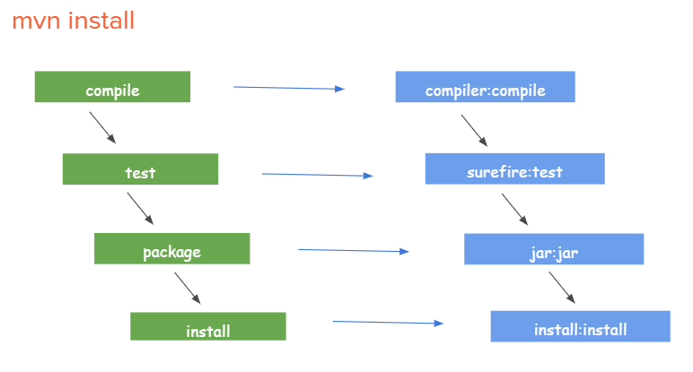
What is Maven?
Phases & Plugin Goals

Slide 26
What is Maven?
Plugins
Compiler plugin
Jar plugin
Javadoc plugin
Examples

Slide 27
What is Maven?
Build section, defaults
Build section in pom file
<build> … </build>
Override defaults
E.g: <build>
<finalName> Payment</finalName>
</build>

Slide 28
What is Maven?
Demo
Create new simple Java Project
Open IDE
File → New Project →
Maven → JDK 17 →
Create from archetype (maven-archetype-quickstart)
Configure name and artifact coordinates (GAV) → Next
Validate setup → Finish
Run Maven goals from cmd:
mvn clean
mvn compile
mvn package
Chain goals

Slide 29
What is Maven?
Dependencies
GAV - Maven Coordinates
are used to identify artifacts.
Together, they identify a 'location' in a Maven Repository
groupId - Typically unique to an organization.
Often the organization's reverse domain is used.
artifactId - typically the project name. A descriptor for the artifact.
version - refers to a specific version of the project.

Slide 30
What is Maven?
Dependencies
Versions
SNAPSHOT
important qualifier to Maven behaviour
tells Maven that this is a development version
not stable, and Maven should check for newer versions
Maven first will check locally, then check remote repository (by default once per day)
RELEASE

Slide 31
What is Maven?
Dependencies
JAR - Java ARchive - Zip file containing one or more Java class files.
WAR - Web Application aRchive - Zip file containing web application. Includes one or more JARs, Java class files and web resources.
EAR - Enterprise ARchive - Zip file containing one or more WAR files.
Packaging Types

Slide 32
What is Maven?
Dependencies
compile - Default. Available on all classpaths of project. Also propagated to downstream projects.
provided - Like Compile, but expected to be provided by JDK or container at runtime.
runtime - Not required for compile, but needed for runtime. On runtime and test classpaths, not compile.
test - only available on test classpath, not transitive.
system - similar to provided, but JAR is added to system explicitly. (via file path)
import - Imports dependency of POM.
Scopes

Slide 33
What is Maven?
Maven Dependencies
Dependency - A dependency is an artifact which your maven project depends upon. Typically a jar or pom.
Transitive Dependencies - A dependency of an artifact which your project depends on.
Dependency Management - allows project authors to specify the versions of artifacts to be used.

Slide 34
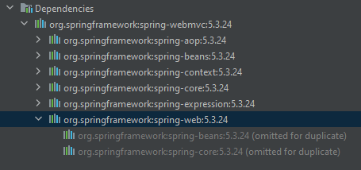
What is Maven?
Dependencies
Transitive dependencies

Slide 35
What is Maven?
Maven Repositories
a location where project artifacts are stored.
Types:
Local - Repository on local file system - <user home>/.m2/.
Central - Public repository hosted by Maven Community - https://repo.maven.org/maven2/
Remote - Other locations - public or private (e.g. Oracle, Google Android)
Private - hosted by companies for internal artifacts.

Slide 36
What is Maven?
Repositories
Central
Project
/.m2 Local
Others..

Slide 37
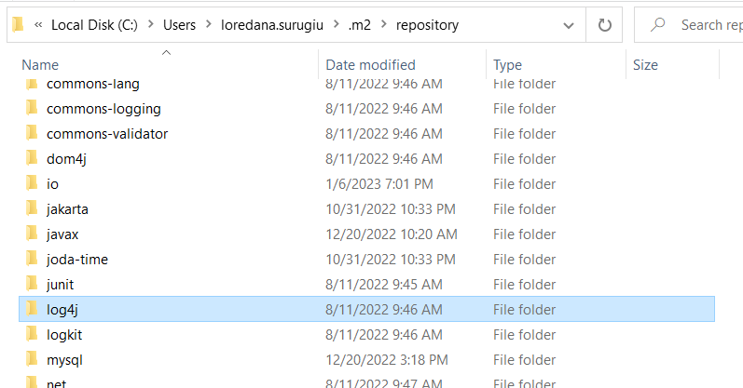
What is Maven?
Repositories
Local repository
~/.m2/repository/<groupId>/
<artifactId>/<version>

Slide 38
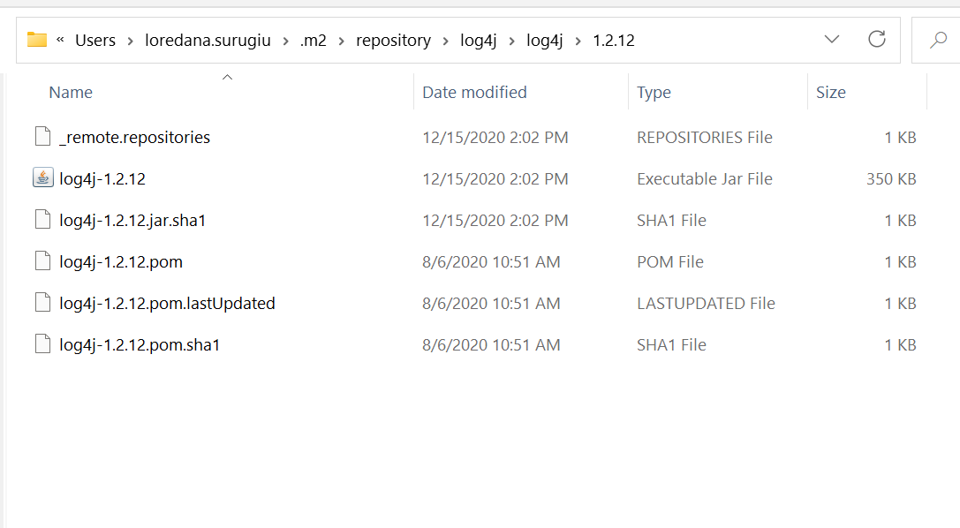
What is Maven?
Repositories
Local repository
~/.m2/repository/<groupId>/
<artifactId>/<version>

Slide 39
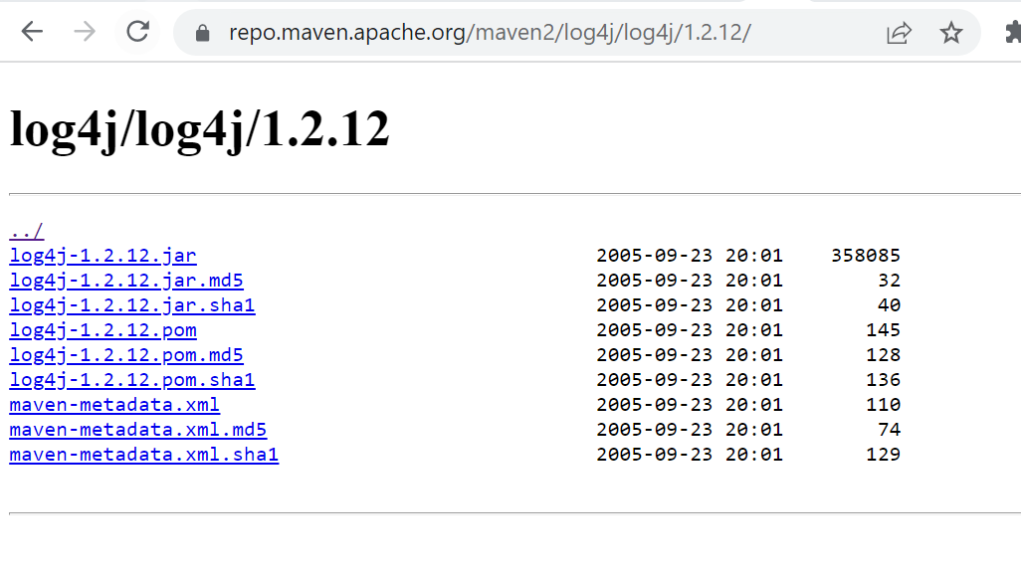
What is Maven?
Repositories
Remote repository
repo.maven.apache.org/maven2
Multiple repos are allowed

Slide 40
What is Maven?
IDE integration
Import as Maven project
From existing sources
From VCS
Create as Maven project
Archetypes = projects templates
E.g. archetype: maven-archetype-webapp

Slide 41
What is Apache Tomcat?

Slide 42
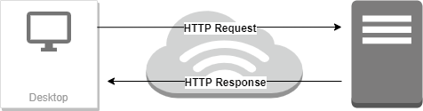
What is Apache Tomcat ?
Just a little bit about HTTP
HTTP Communication protocol between browser and web server Uses plain text

Slide 43
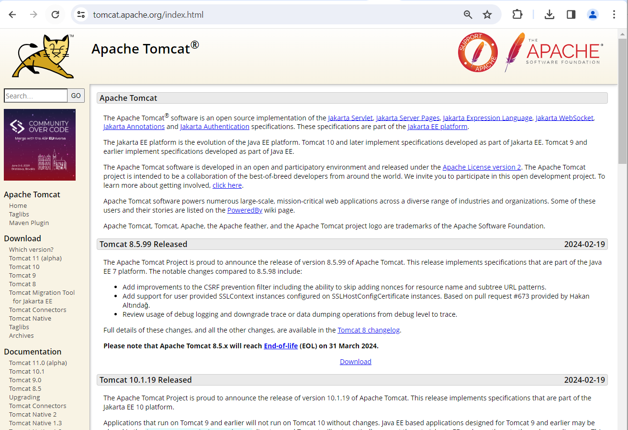
What is Apache Tomcat ?
High level overview
Web server Maintained by Apache Open source Implements Servlet Specification

Slide 44
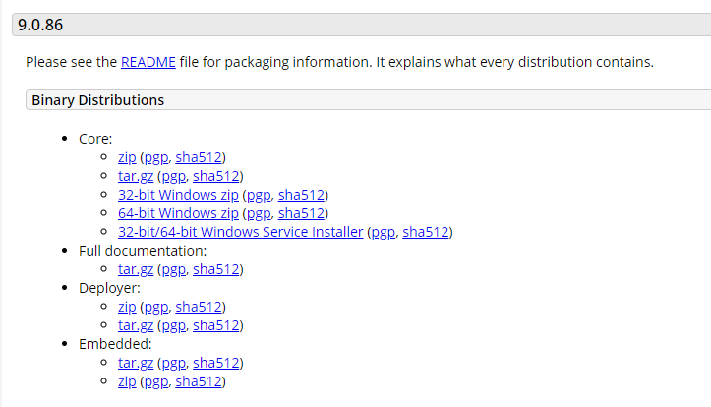
What is Apache Tomcat ?
Set up
Download Tomcat 9 from Apache: https://tomcat.apache.org/download-90.cgi

Slide 45
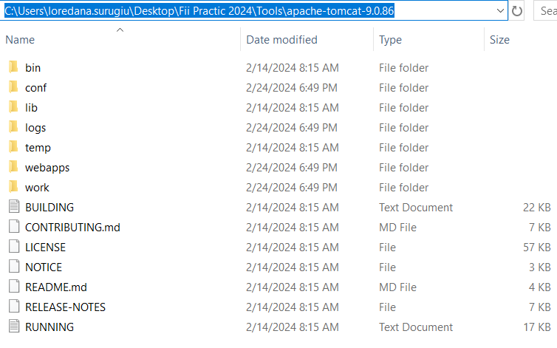
What is Apache Tomcat?
Set up
Installation Unzip it and put it under the C drive

Slide 46
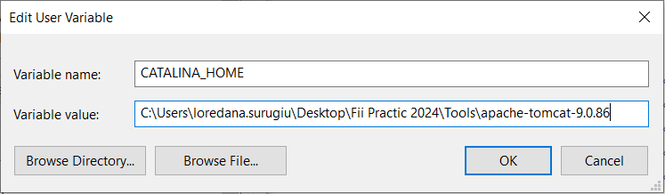
What is Apache Tomcat?
Set up
Add environment variables JAVA_HOME CATALINA_HOME

Slide 47
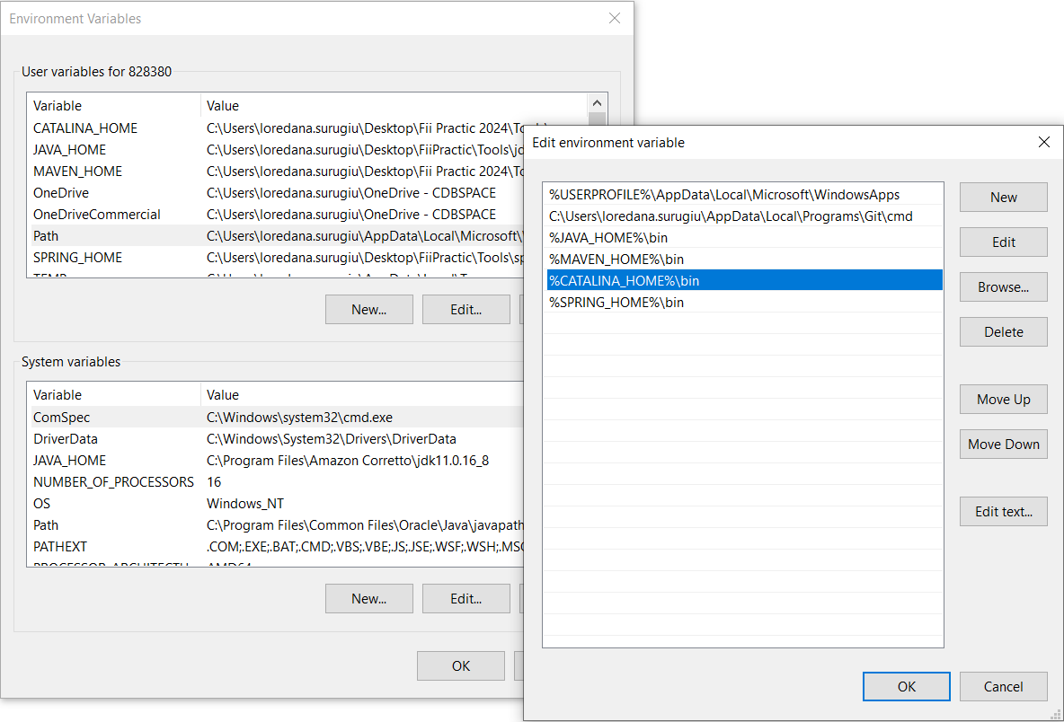
What is Apache Tomcat?
Set up
Edit environment variable
Setup Path

Slide 48
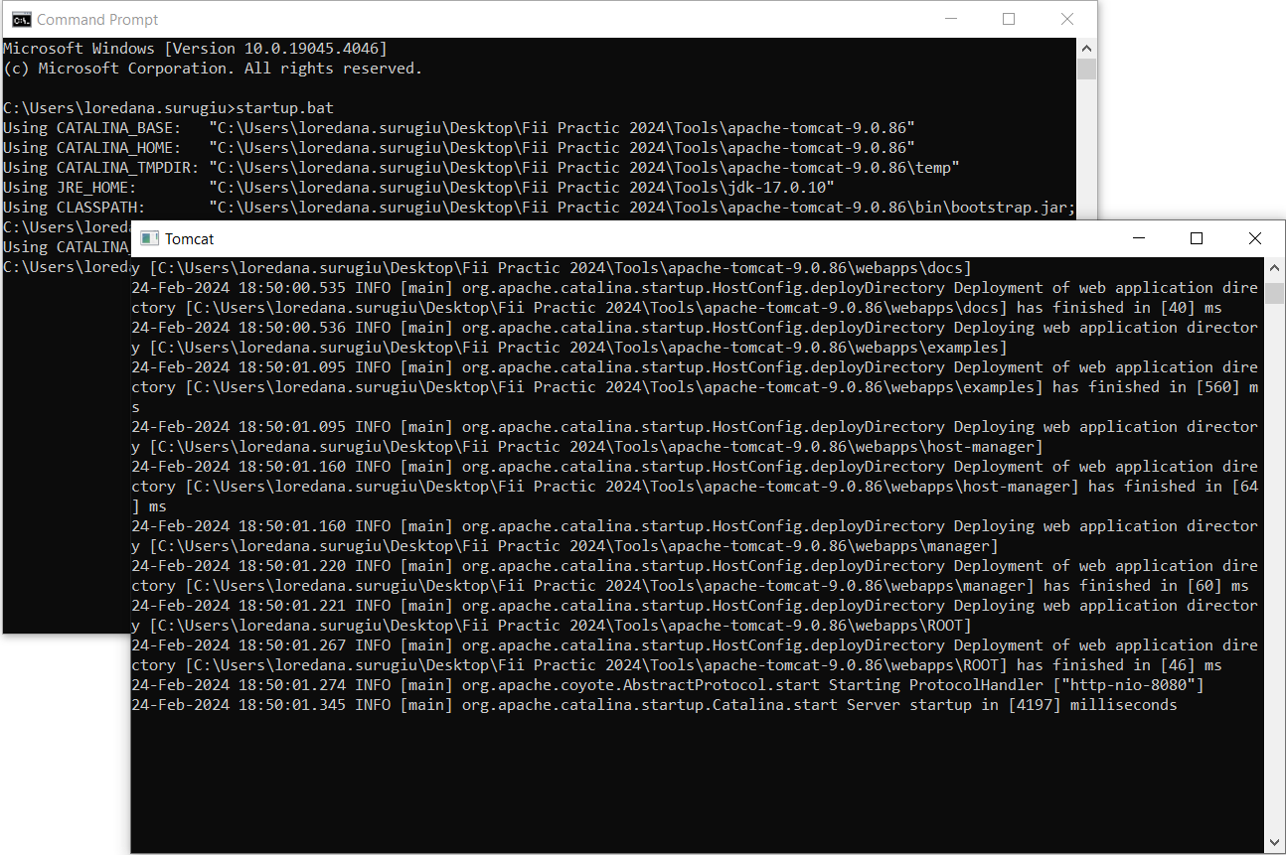
What is Apache Tomcat?
Set up
Start Tomcat run startup.bat Stop Tomcat run shutdown.bat

Slide 49
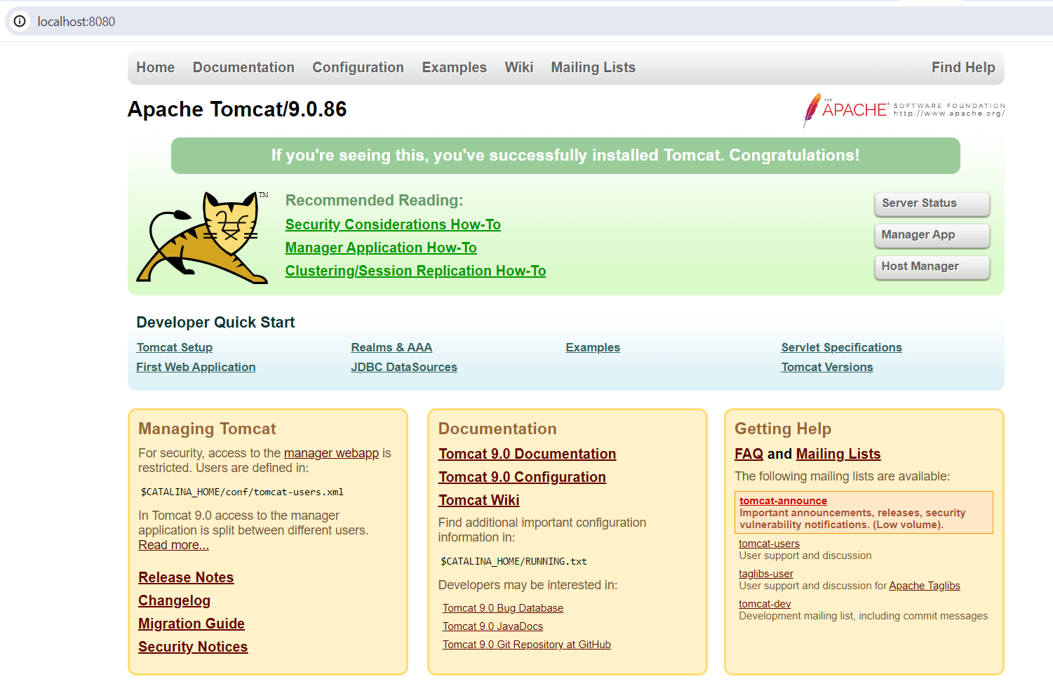
What is Apache Tomcat?
Set up
Validate installation Open a browser Navigate to localhost:8080

Slide 50
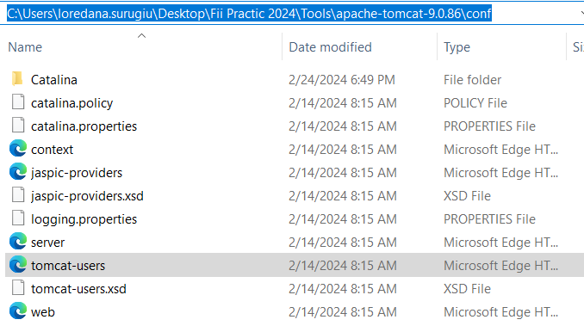
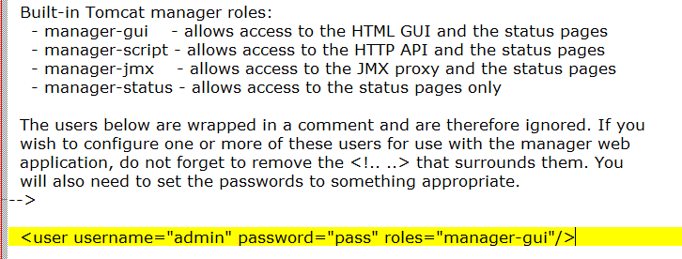
What is Apache Tomcat?
Set up
Access Manager App
Navigate to apache-tomcat-9.0.86/conf and open tomcat-users in Notepad
Setup username and password and manager-gui role

Slide 51
What is Apache Tomcat?
Basic application example
Create new web app project
Open IDE
File → New Project →
Maven → JDK 17 →
Create from archetype (maven-archetype-webapp)
Configure name and artifact coordinates (GAV) → Next
Validate setup → Finish

Slide 52
What is Apache Tomcat?
Basic application example
Configure web app
Add the servlet dependency
In pom.xml file go to <dependencies> and add javax.servlet-api
<dependency> <groupId>javax.servlet</groupId> <artifactId>javax.servlet-api</artifactId> <version>4.0.1</version> </dependency>
Maven → reload project
Override maven.compiler.source and maven.compiler.target to 17
Add a new Java class for Servlet (extends HttpServlet)
Override doGet method:
response.getOutputStream().println("Hello from Fii Practic!");
Add WebServlet annotation
@WebServlet("/hello")

Slide 53
What is Apache Tomcat?
Basic application example
Build web app
mvn clean package
Deploy web app
Go to target
Copy .war file to tomcat\webapps
Start tomcat
Check your app in browser at the URL
localhost:8080/_warname_/_servletpath_
(e.g. http://localhost:8080/FiiPractic/hello)

Slide 54
What is Git?

Slide 55

What is Git?
What is ...
a Version Control System (VCS) ?
GIT?
GitHub and how it relates to GIT?
a branch?

Slide 56
What is Git?
Repository interaction commands:
Fetch
Pull
Push
Local commands:
Status
Checkout
Merge
Commit

Slide 57
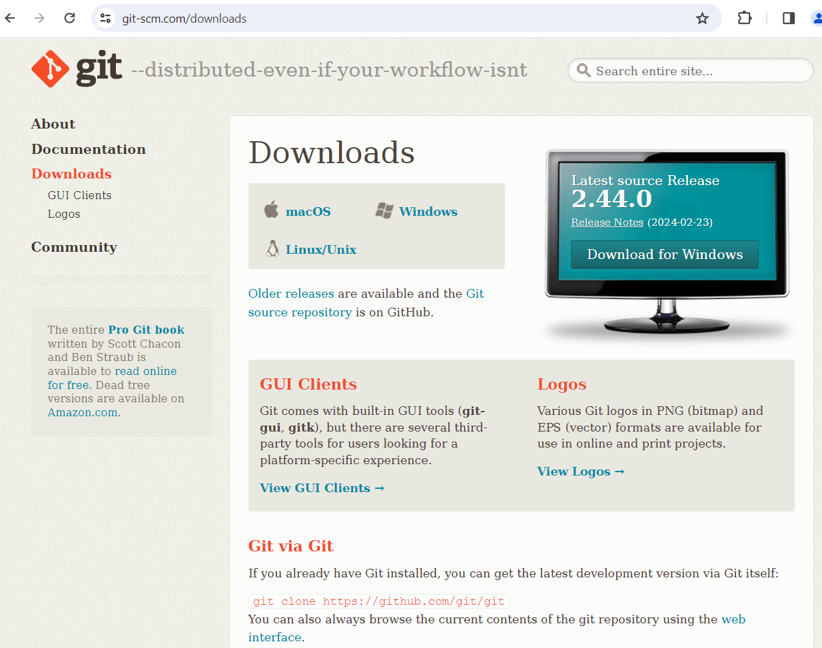
What is Git?
Install & Setup
Download
https://git-scm.com/downloads
Create GitHub account
https://github.com/

Slide 58
Thank You!

